Slide 1
Solutions for Creating a Safer, Healthier Workplace Environment

Slide 2
Safe Space Solution
Ensuring safe, clean workspaces for your employees with workspace technology

Slide 3
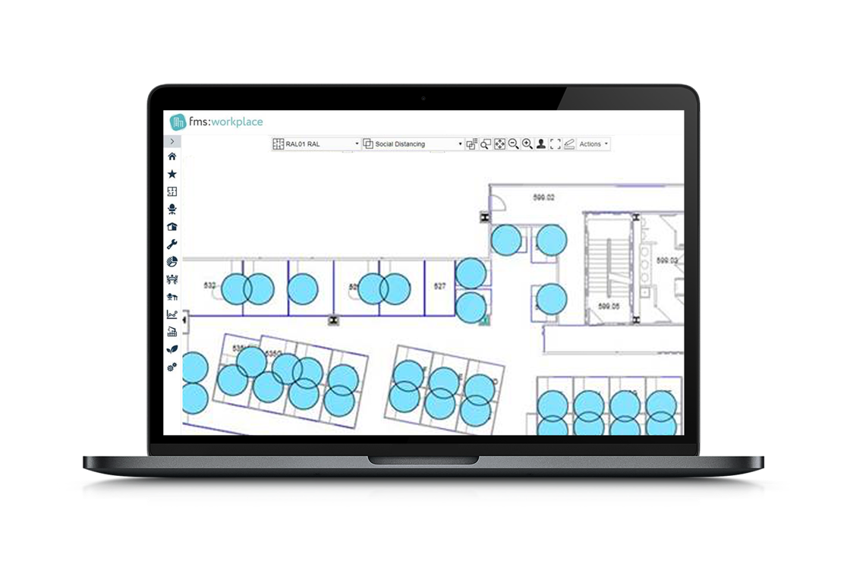
Measuring Social Distancing In Your Space
Understand the limits of your current layout in order to maintain social distancing requirements
TOO CLOSE

Slide 4
Safe Space Solution
Measuring Social Distancing In Your Space
Desk Reserved through Hoteling
Desk Vacated
Cleaning Ticket Dispatched
Desk Becomes Available
Analytics Measuring Occupancy, Environmental, Ticketing (with SLAs)

Slide 5
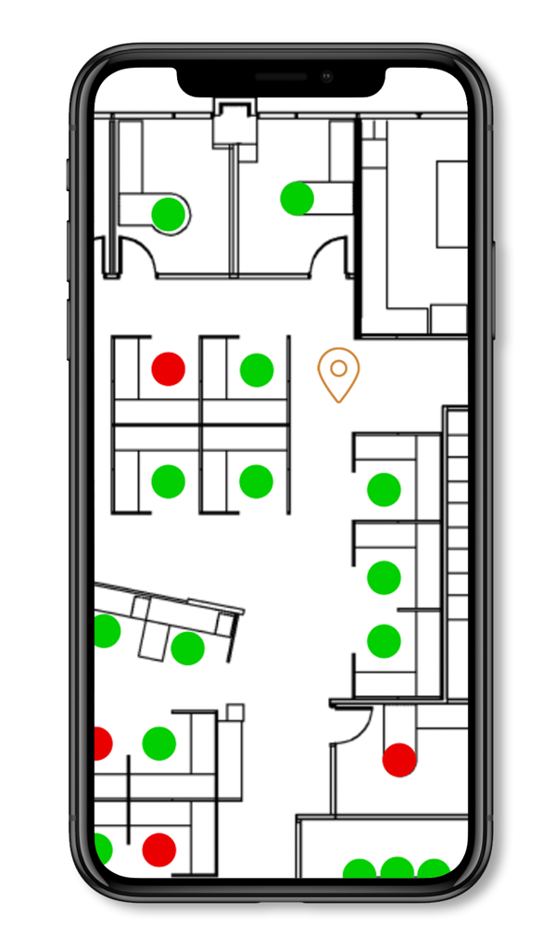
Desk Reserved through Hoteling
Reserved through hoteling solution

Slide 6
Safe Space Solution
Measuring Social Distancing In Your Space
Desk Reserved through Hoteling
Desk Vacated
Cleaning Ticket Dispatched
Desk Becomes Available
Analytics Measuring Occupancy, Environmental, Ticketing (with SLAs)

Slide 7
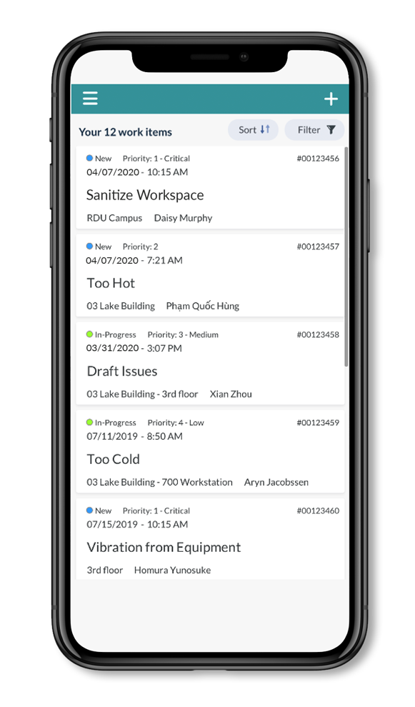
Desk Vacated
Triggering Service Request for Sanitation

Slide 8
Safe Space Solution
Measuring Social Distancing In Your Space
Desk Reserved through Hoteling
Desk Vacated
Cleaning Ticket Dispatched
Desk Becomes Available
Analytics Measuring Occupancy, Environmental, Ticketing (with SLAs)

Slide 9
Cleaning Ticket Dispatched
Via Mobile Maintenance App

Slide 10
Safe Space Solution
Measuring Social Distancing In Your Space
Desk Reserved through Hoteling
Desk Vacated
Cleaning Ticket Dispatched
Desk Becomes Available
Analytics Measuring Occupancy, Environmental, Ticketing (with SLAs)

Slide 11
Desk Becomes Available
Automatically once ticket is complete

Slide 12
Safe Space Solution
Measuring Social Distancing In Your Space
Desk Reserved through Hoteling
Desk Vacated
Cleaning Ticket Dispatched
Desk Becomes Available
Analytics Measuring Occupancy, Environmental, Ticketing (with SLAs)

Slide 13
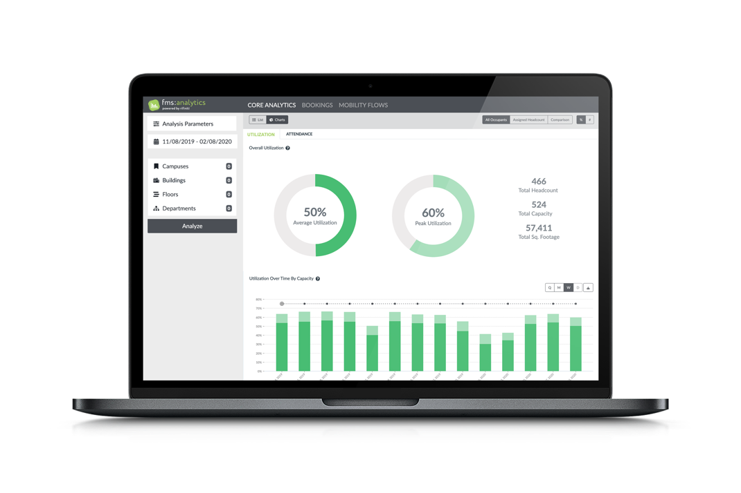
Analytics Measuring Utilization & Process
Measuring Occupancy, Environmental and Ticketing (with SLAs)

Slide 14
Safe Space Solution
Measuring Social Distancing In Your Space
Desk Reserved through Hoteling
Desk Vacated
Cleaning Ticket Dispatched
Desk Becomes Available
Analytics Measuring Occupancy, Environmental, Ticketing (with SLAs)

Slide 15
Preparing for the Return to Work:
Crawl: Reservations and Usage
Walk: Fine-Tuning
Run: Integrations and Expansions
Activation: Implementation, Installation and Training

Slide 16
Crawl
Mobile/Web/On-Demand/Concierge
Real-time Usage and Scheduling
Planning/Contamination
Notes:
Crawl: We’re going to cover three topics:
The Amazonian user experience when finding a space to return to work
Understanding our real-time usage and managing scheduling
Planning / Contamination

Slide 17
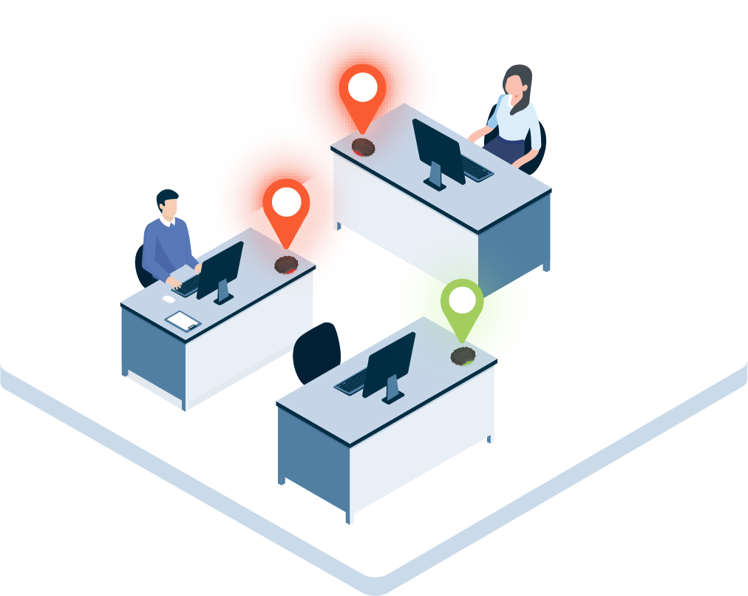
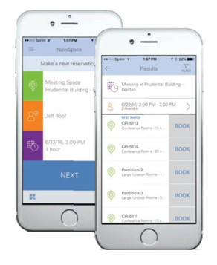
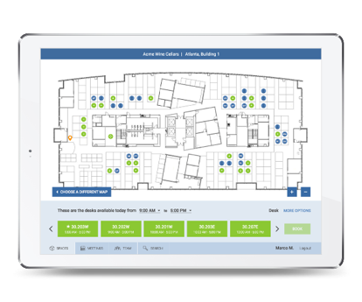
Mobile
Web
On-Demand
Concierge
Notes:
What we are going to focus on here is the Amazonian user experience when finding a space to return to work
System supports multiple workflows, from full self-service booking, to full concierge, and everywhere in-between.

Slide 18
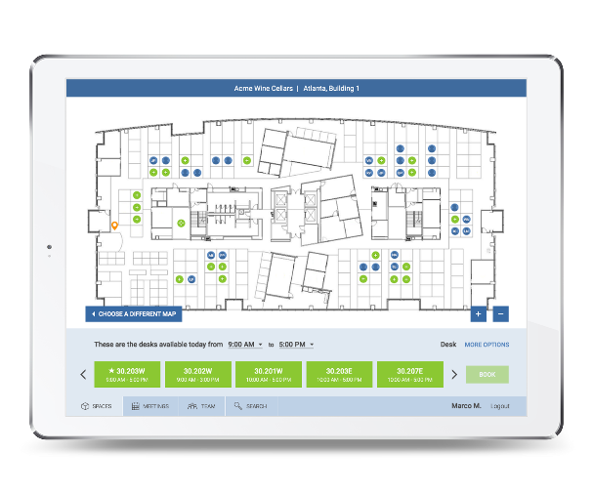
Web
Notes:
Let’s take a look at the web experience and booking from interactive floor plans

Slide 19
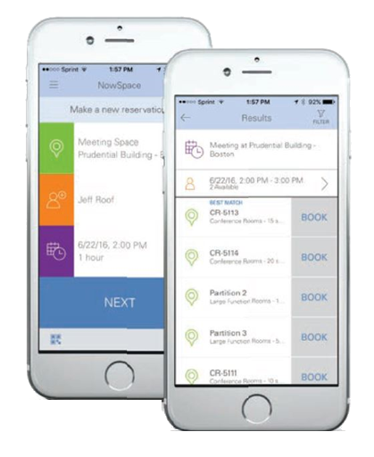
Mobile
& QR
Notes:
Let’s take a look at the mobile experience

Slide 20
Concierge
Notes:
Let’s take a look at the concierge booking approach (centrally managed spaces)
MapView – book on behalf of, activate/deactivate spaces
Web – planner view, reservation wizard, book oh behalf of someone

Slide 21
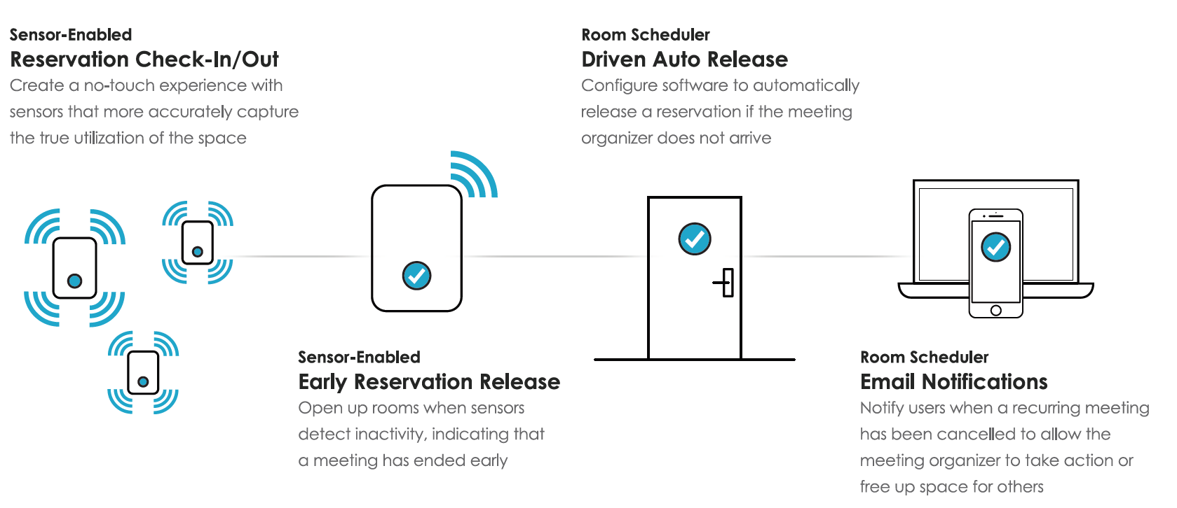
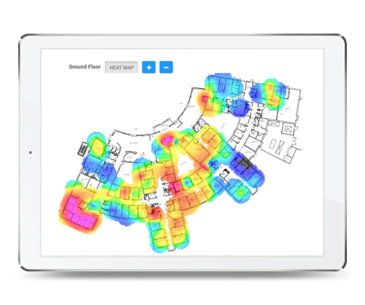
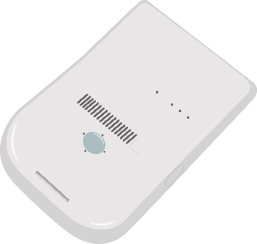
Real-time Usage
& Scheduling
Notes:
Sensor integration
Show dashboard
Barclay’s scale slide next

Slide 22
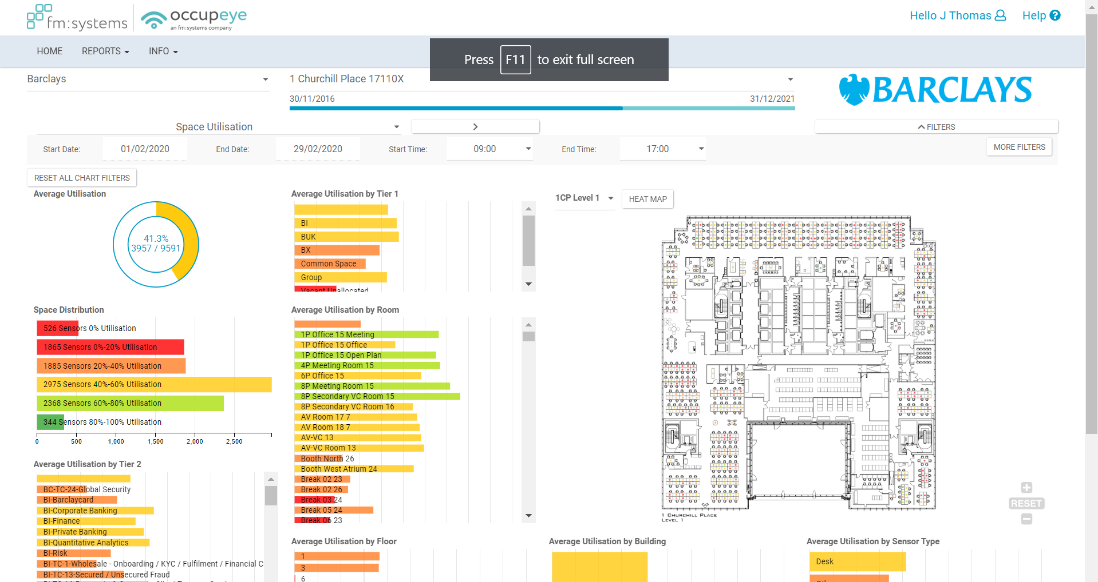
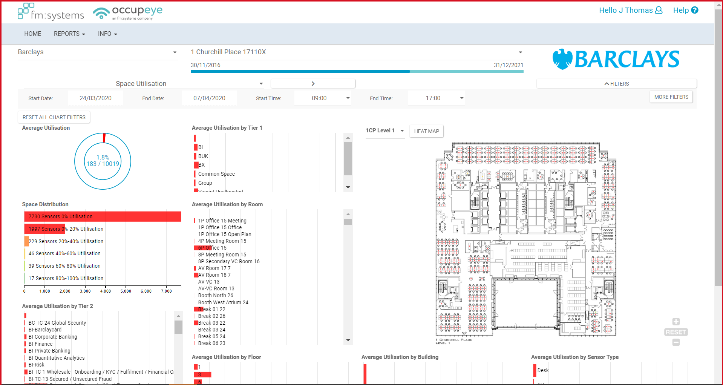
Notes:
What we’re going to focus on here is understanding our real-time usage and managing scheduling
Sensor integration
Live-View
Planner View

Slide 23
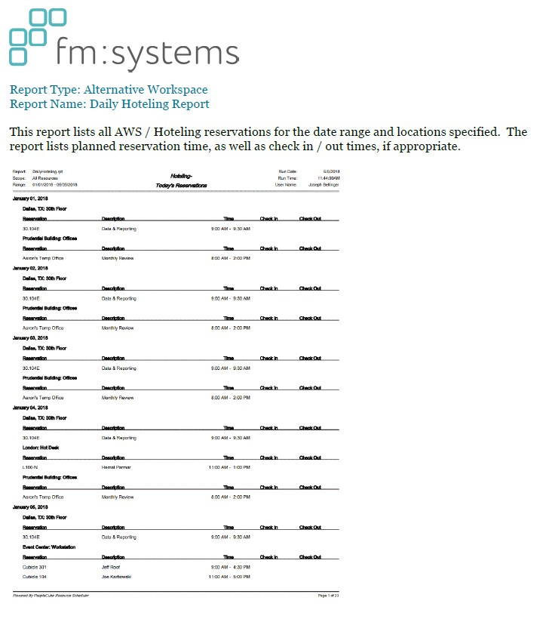
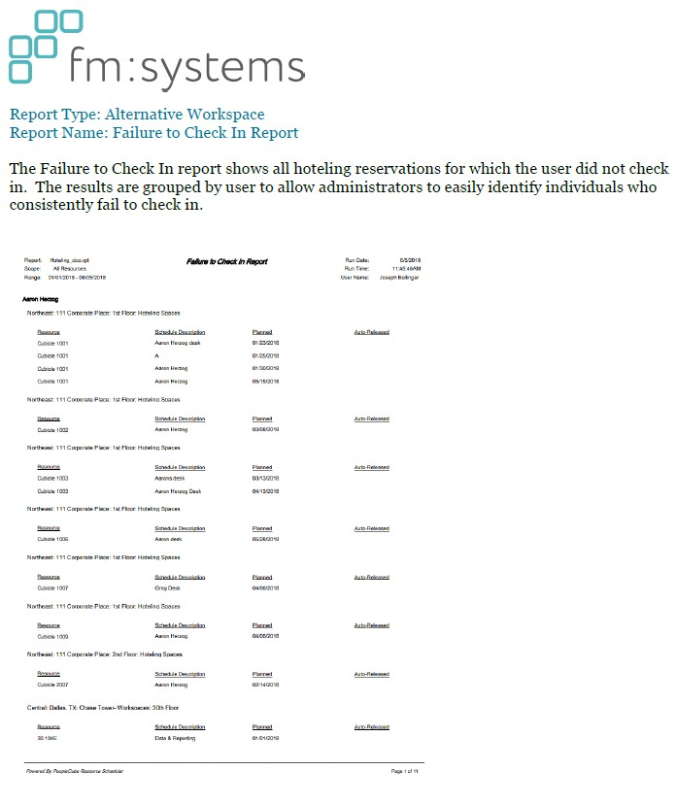
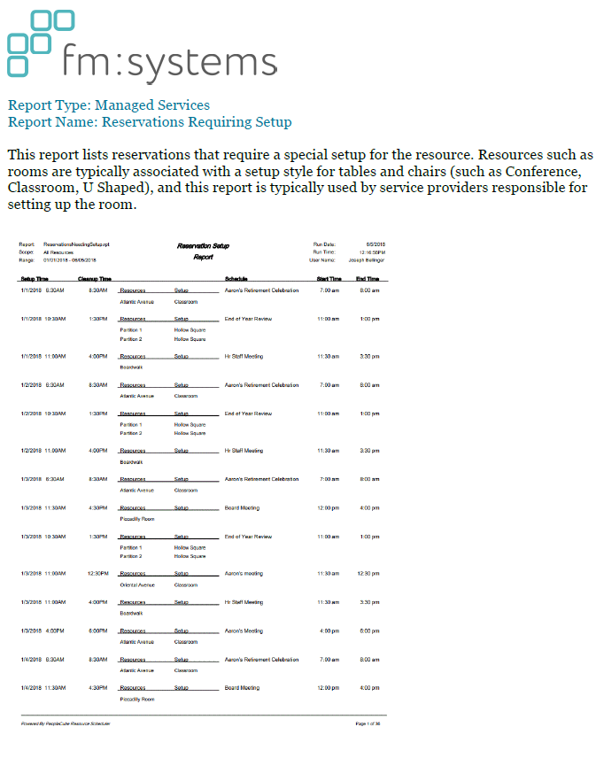
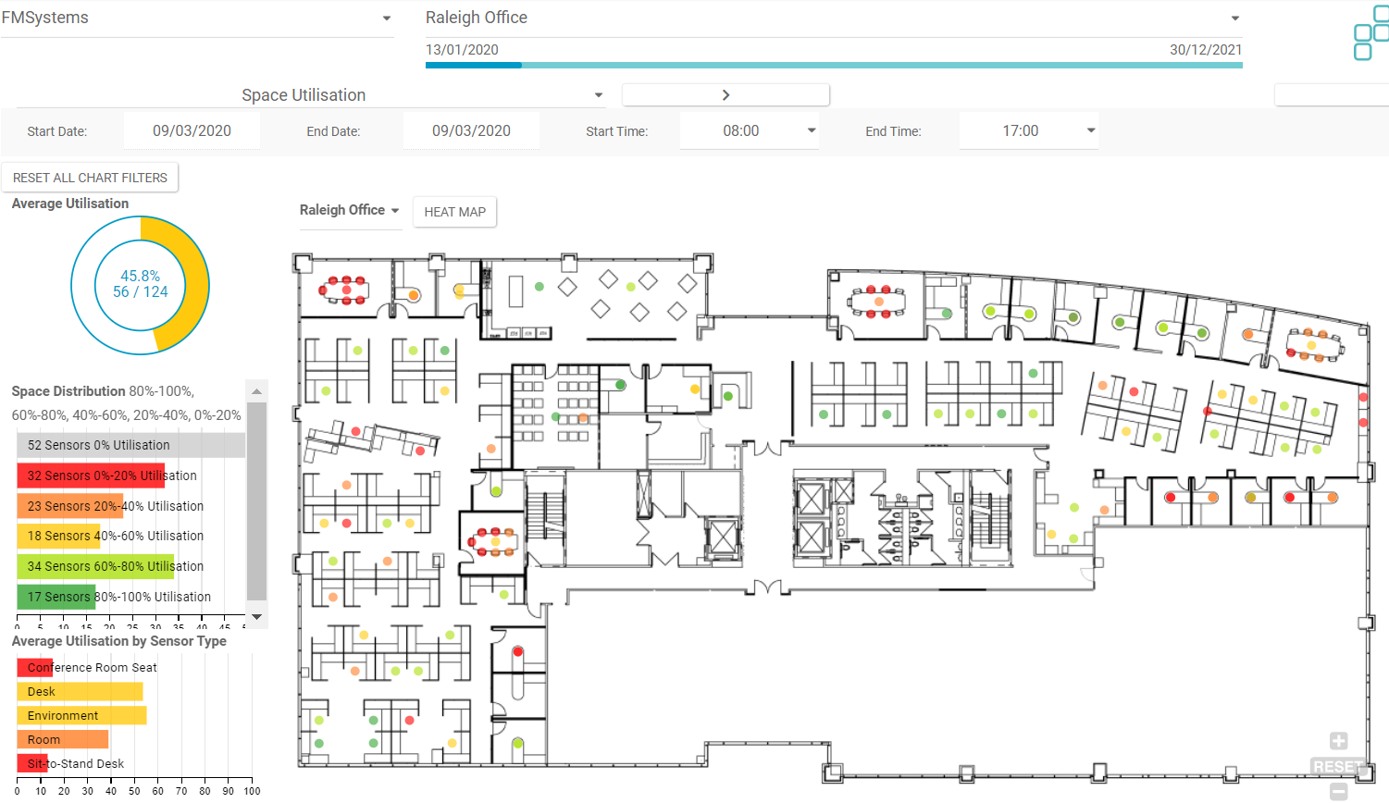
Planning/Contamination
Notes:
Reports
Service Scheduler – Change to Spanish, update request in real-time (sanitation request, process) completed on mobile, auto-updates

Slide 24
Walk
Advanced configurations
Expanded User Access Points
Heatmaps / Employee Mobility Flows
Notes:
Crawl: We’re going to cover three topics:
The Amazonian user experience when finding a space to return to work
Understanding our real-time usage and managing scheduling
Planning / Contamination

Slide 25
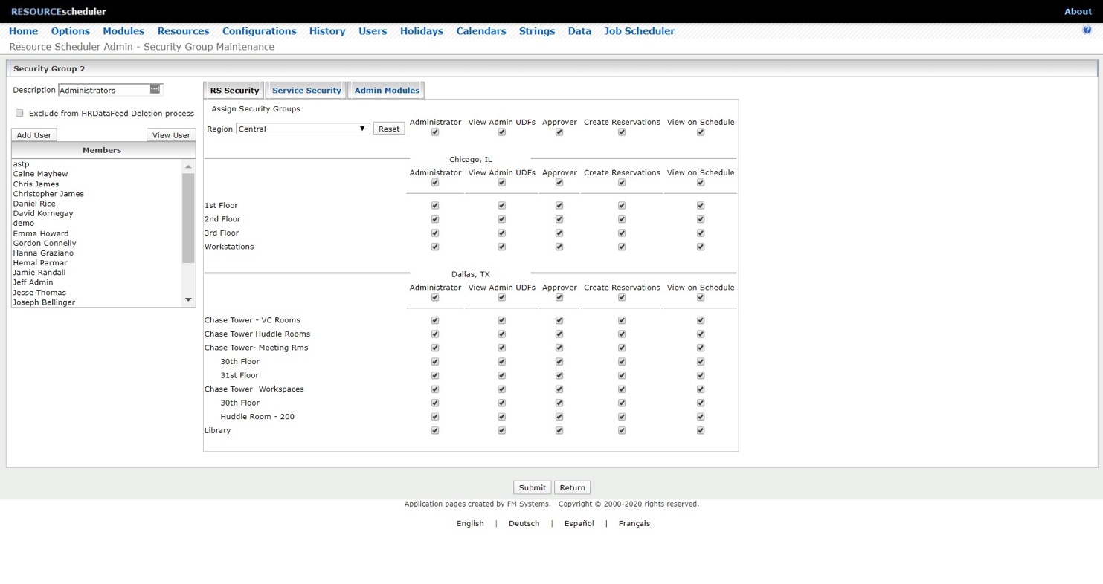
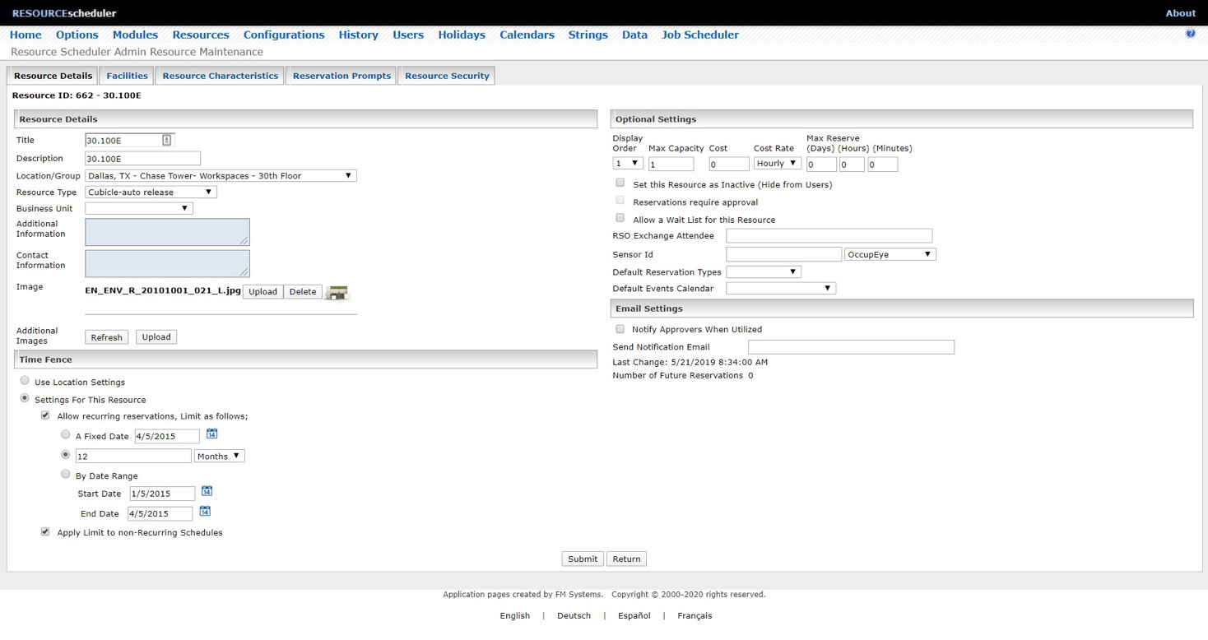
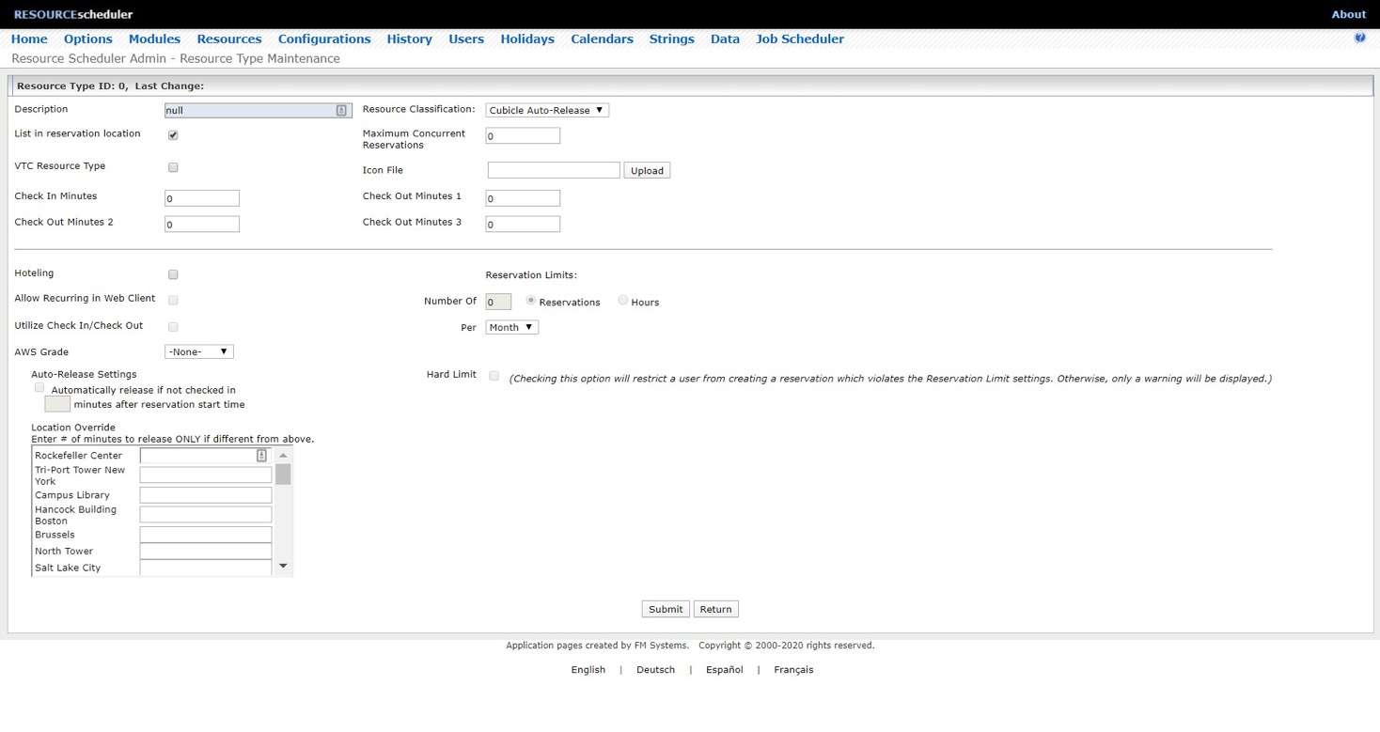
Advanced
Configurations
Notes:
Resource Details
Resource Types
User Security Groups

Slide 26
Expanded User
Access Point
Notes:
Outlook
Panels
Lobby Displays

Slide 27
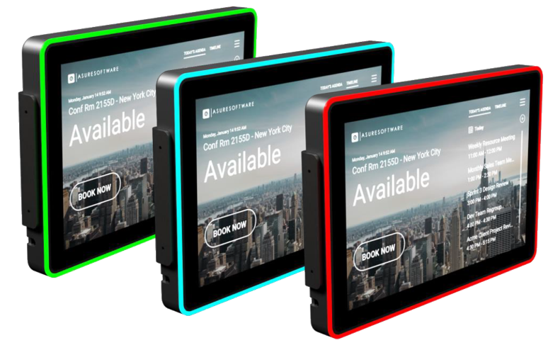
Room Panels
Check-in option to alleviate “no shows”
View or Create future meetings
Extend or End existing reservations
Start Meeting option via panel or sensors
Centralized management and maintenance
Modern Interface with customizable backgrounds and branding
10.1” touch screen 1280 x 800 resolution 16 customizable LED color options 2 GB system memory 16 GB flash memory | POE or DC Adapter Ethernet or WiFi connectivity VESA or glass mount CE & FCC Certified Optional RFID badge reader
27
Notes:
Outlook
Panels
Lobby Displays

Slide 28
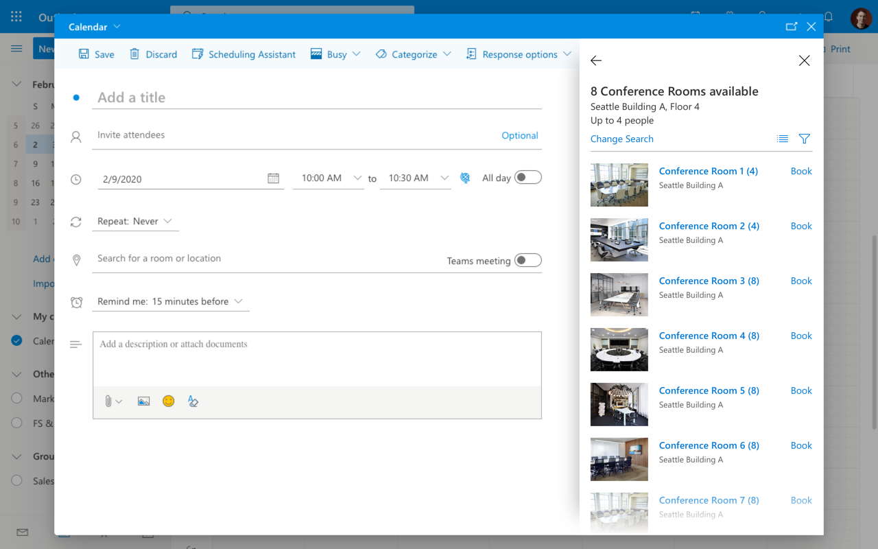
Outlook Web
Add-In
28
Notes:
Outlook
Panels
Lobby Displays

Slide 29
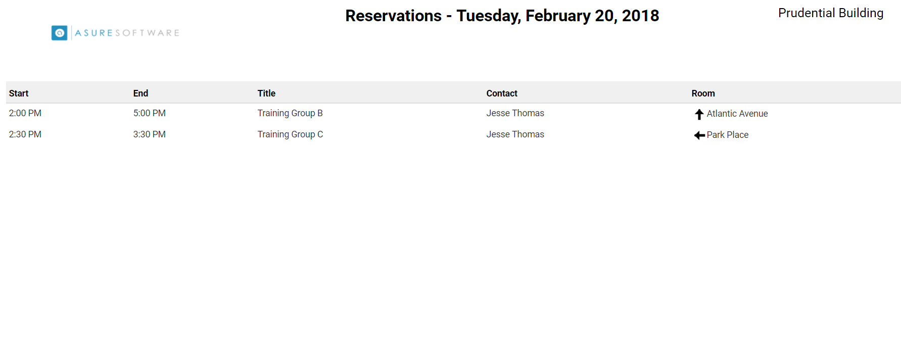
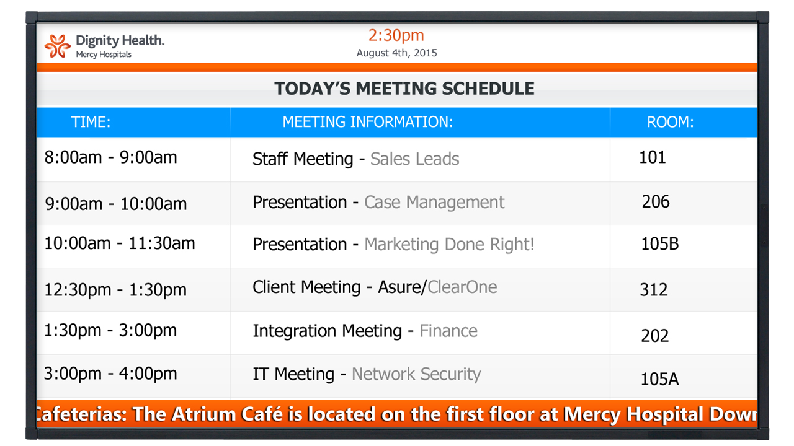
Reservations Lobby Display
Display today’s events for easy reference
Enhance wayfinding and reduce confusion
Configurable and customizable
Can create multiple displays
Integrates easily with digital signage technology
29
Notes:
Outlook
Panels
Lobby Displays

Slide 30
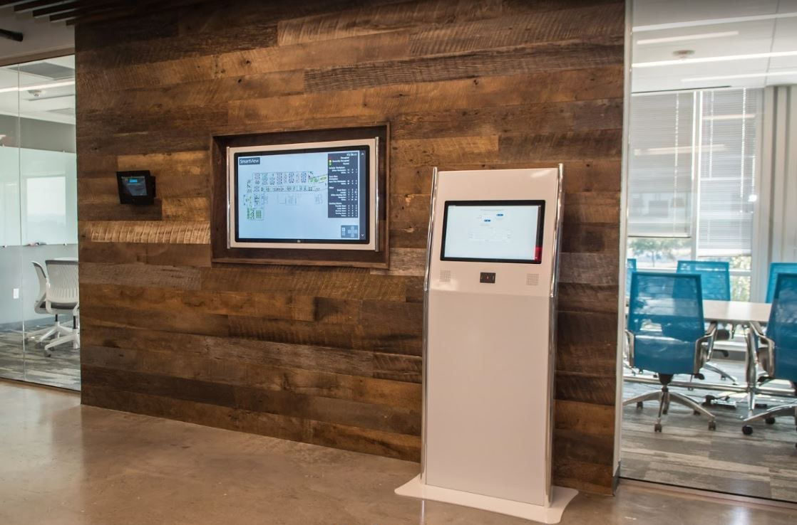
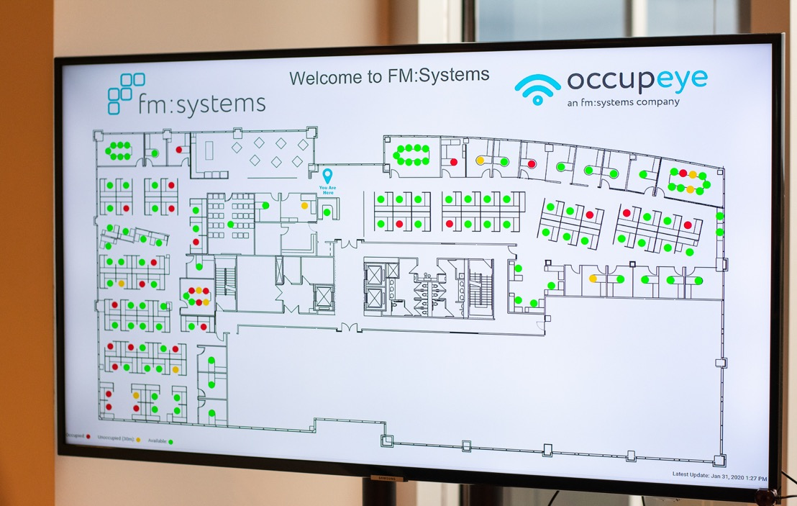
OccupEye Live View:
Assists employees in wayfinding
Displays:
Unoccupied Spaces
Recently Occupied Spaces
Currently Occupied Spaces
Interactive Kiosk:
Allows for:
Ad Hoc bookings
Desk/Room
Find coworker/team

Slide 31
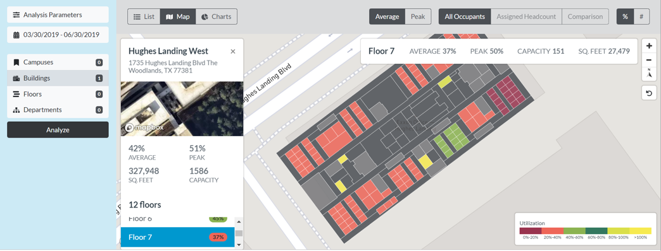
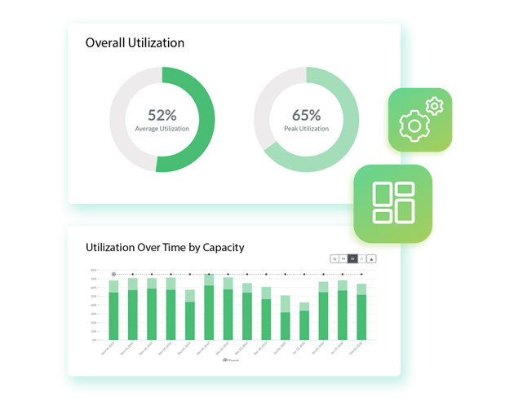
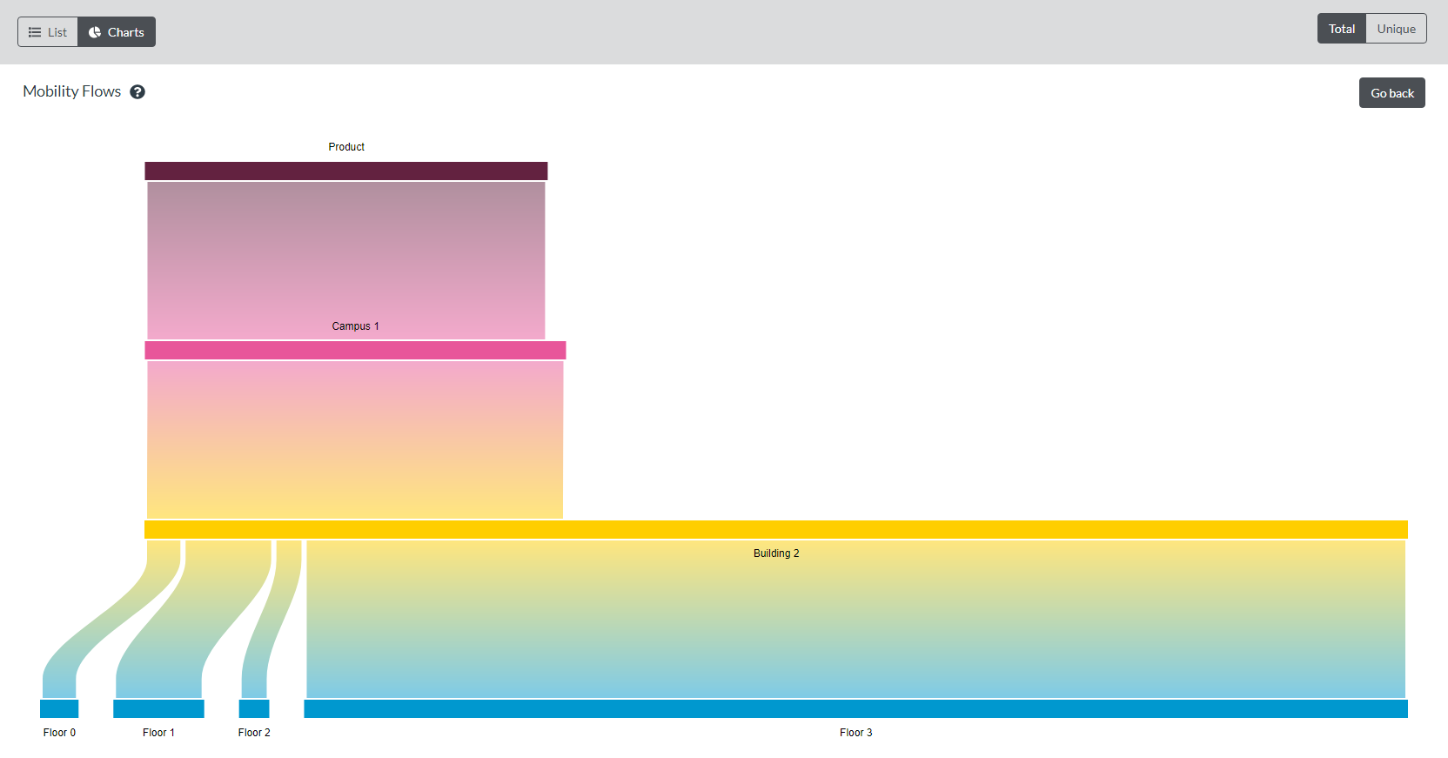
Heat Maps &
Employee Mobility Flows
Notes:
Heat Maps
EE Mobility Flows (Rifinity screens)
Environmental sensors

Slide 32
Run
Integrations: API toolkit
RS Advanced Reporting
Additional data sources (Wi-Fi, Badging)
FM Integration (floor plan integration)
Notes:
Crawl: We’re going to cover three topics:
The Amazonian user experience when finding a space to return to work
Understanding our real-time usage and managing scheduling
Planning / Contamination

Slide 33
WebServices API
Digital Signage
IWMS
CAFM
Analytics
Integrations:
API Toolkit
Human
Resources
Single
Sign-On
3rd Party Applications
Notes:
API Toolkit
SOAP/REST API available

Slide 34
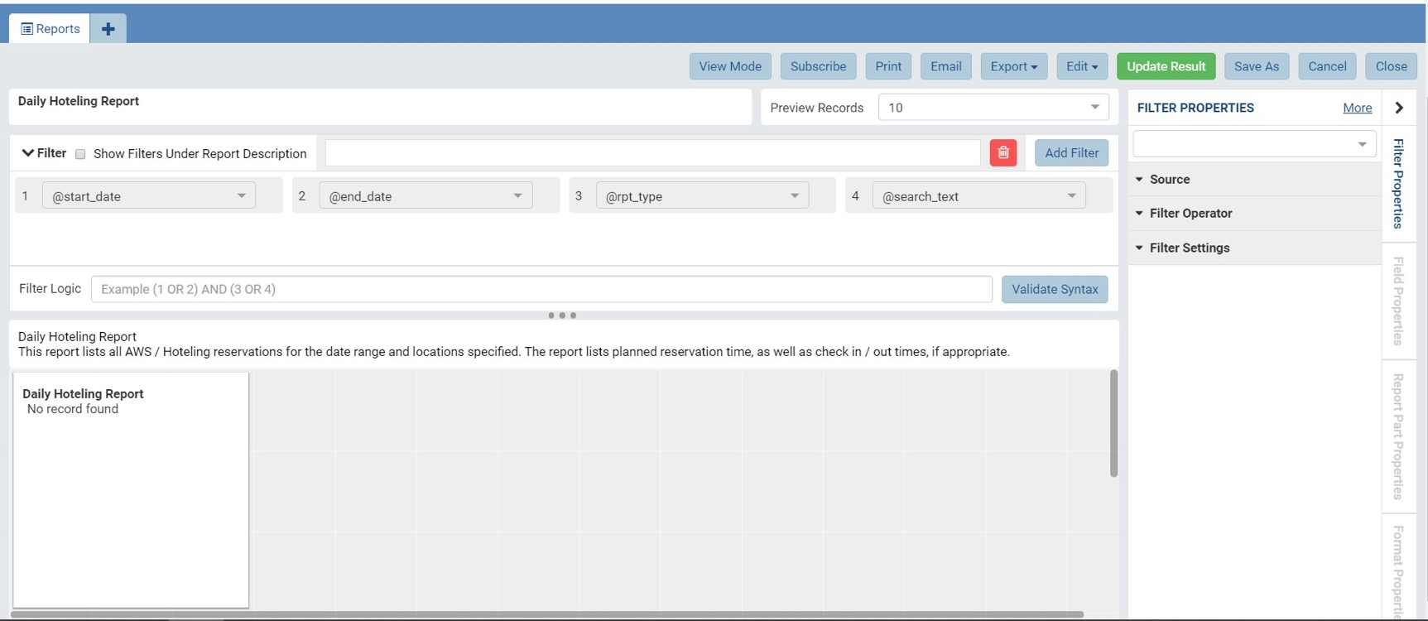
Advanced Reporting
Notes:
Customize and create reports
Create subscriptions and automate delivery

Slide 35
Additional Data Sources:
Badging, Wi-Fi
DATA COLLECTION
DATA SCIENCE
ADVANCED ANALYTICS
Continuously collects & harmonizes data from multiple, existing sources to enhance quality & utility
Data analyzed using FMS:Analytics’ algorithms - over a billion iterations
Actionable results about space use, mobility & collaboration
Notes:
API Toolkit
SOAP/REST API available

Slide 36
FMS:Workplace Integration
Notes:
API Toolkit
SOAP/REST API available

Slide 37
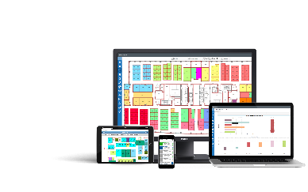
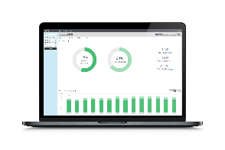
The Ideal Workplace
Solution Areas
Workplace
Management
Employee Experience
Workplace
Analytics

Slide 38
Activation
Implementation: API toolkit
Installation
Training
Notes:
Crawl: We’re going to cover three topics:
The Amazonian user experience when finding a space to return to work
Understanding our real-time usage and managing scheduling
Planning / Contamination

Slide 39
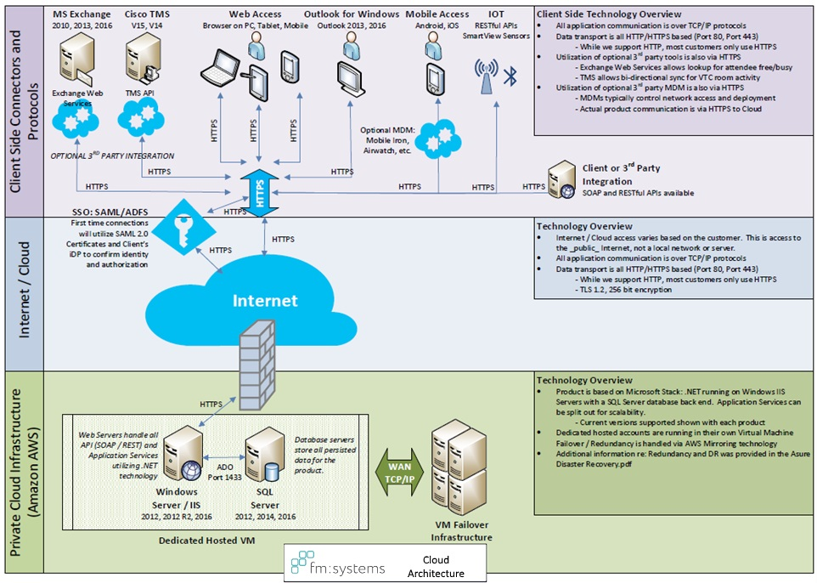
Network
Architecture
Notes:
API Toolkit
SOAP/REST API available

Slide 40
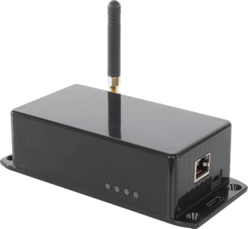
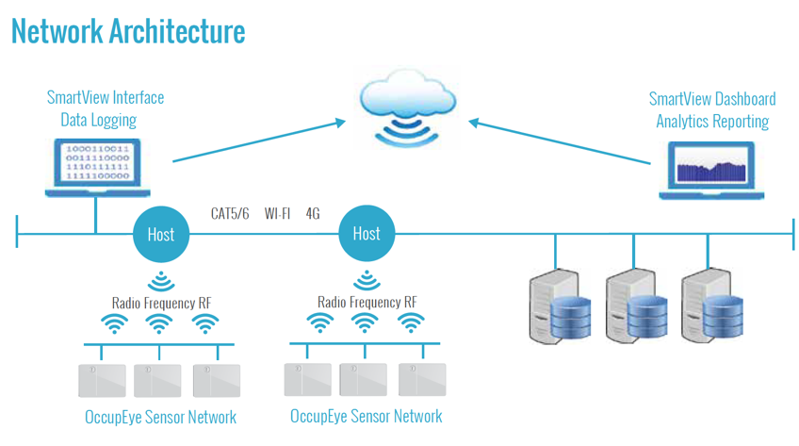
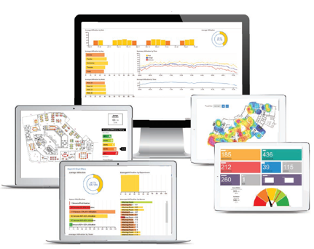
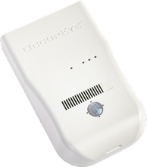
Sensor:
PIR (Passive Infrared)
No PII
Anonymized Data
Battery / USB powered
Environmental Data:
Host:
Manages data transfer from sensor
Multiple connection options:
Wi-Fi, Ethernet, Cellular 4G
Dashboard:
Access via web browser
Access via mobile devices
HTML 5 responsive
Deep analytical reports
Exporting options for data

